Slide 1
Machine learning methods for the analysis of data of an Electricity Distribution Network Operator
Master’s thesis
Aristotle University of Thessaloniki, Faculty of Sciences, Department of Informatics
Supervisor: Dr. Eleftherios Angelis; Thesis Committee: Grigorios Tsoumakas, Ioannis Vlahavas
Ioannis Mamalikidis, UID: 633

Slide 2
Layout
Introduction
Pre-Processing
Model Evaluation
Machine Learning
Conclusions

Slide 3
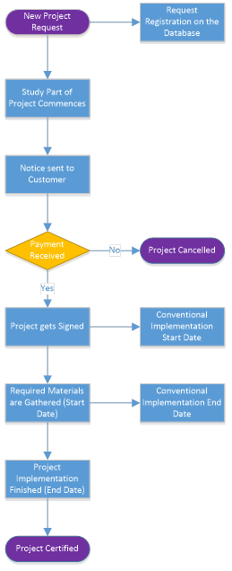
Introduction [1/2]
Machine Learning
Optical Character Recognition
Search Engines
…
Medical Field
Types:
Unsupervised
Supervised
Semi-Supervised
Power producer and electricity supply
Operation, maintenance & development of Distribution Network
Medium and Low Voltage electricity to 7.4 million customers
High Voltage networks in Attiki and in the non-interconnected islands
The Hellenic Electricity Distribution Network Operator
HEDNO S.A.

Slide 4
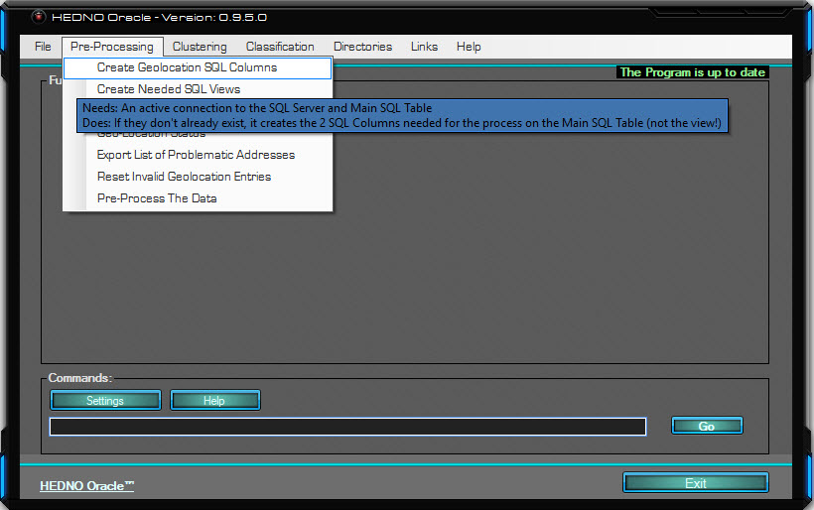
Introduction [2/2]
Pre-Processing
Geolocation
Check for Problematic Entries
Pre-Process
Clustering
Step 0
Step 1
Classification
Form Training & Testing Sets
Model Training
Predictions & Statistics

Slide 5
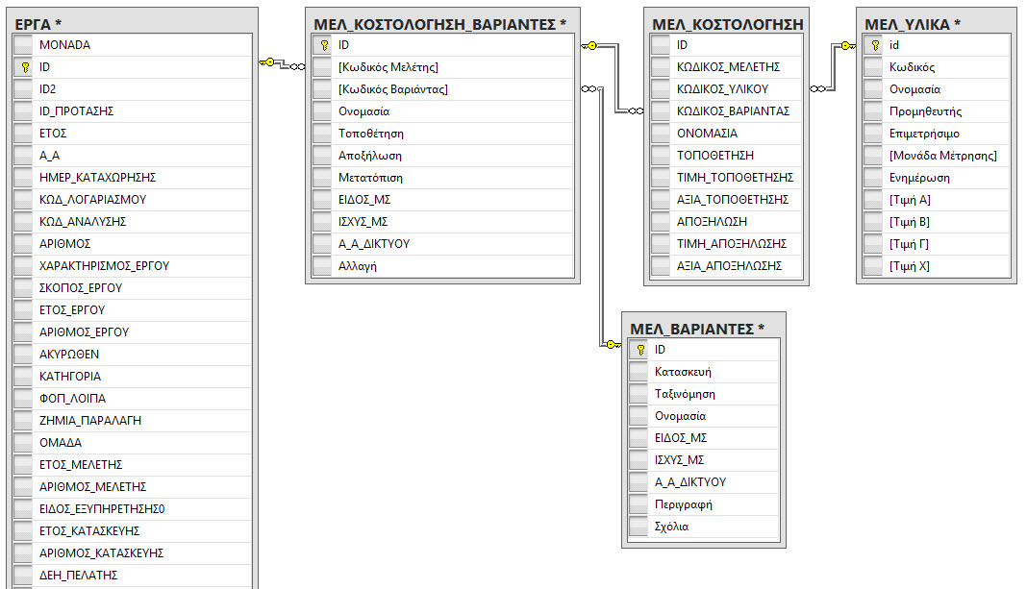
Pre-Processing [1/2]
Rough Estimates
More than 400,000 Projects
More than 2,500,000 Sets of Tasks
More than 3,000 Distinct Sets of Tasks
More than 17,000,000 Items
More than 3,500 Distinct Items
Data
Organised for the company’s convenience
Many different Aspects/Types
Noise, Erroneous/Invalid Entries
Company-Data Quirks
Abstraction Levels

Slide 6
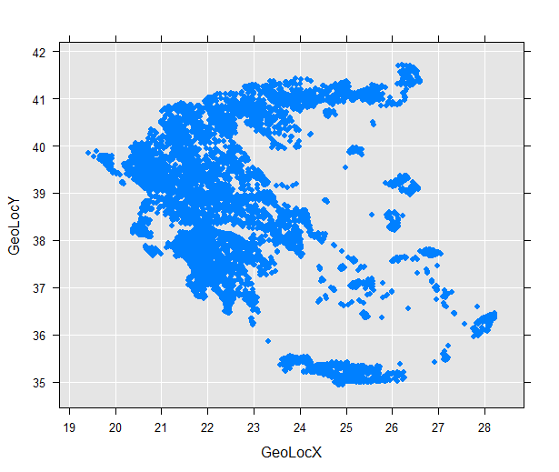
Pre-Processing [2/2]
SQL Views
Variables Used As is
Transformations
Feature Engineering
Clauses
Final Dataset
Location
Geolocating
Google API
API Limitations
Legal Limitations
End Result

Slide 7
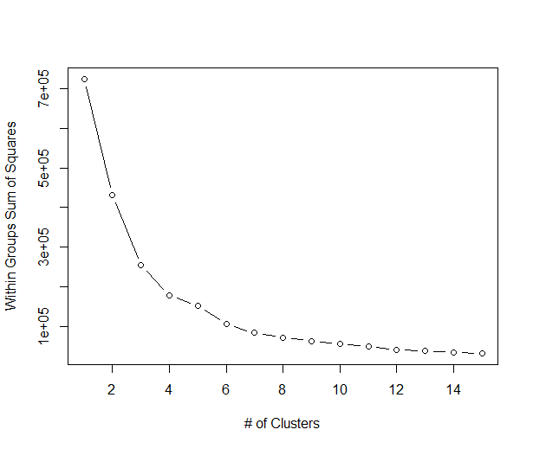
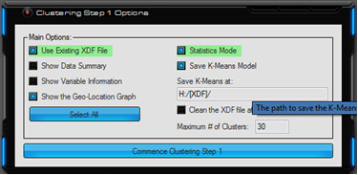
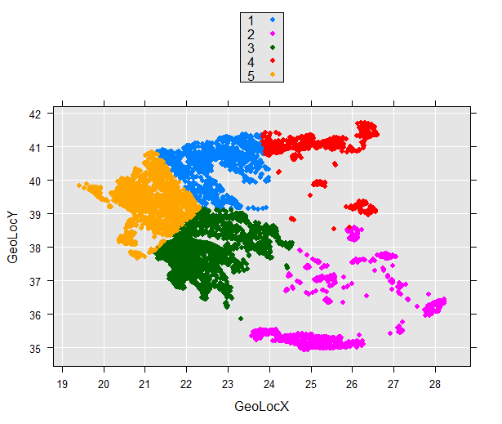
Machine Learning [1/3]
Paradigm
Multi-Threaded
Concurrent
Cluster-Ready
Programmes
R Language
Microsoft ScaleR
VB.NET
Unsupervised Learning
K-Means
Sum-of-Squared-Error
HEDNO S.A Data
Spatial Proximity
Commonality
Geological Aspect

Slide 8
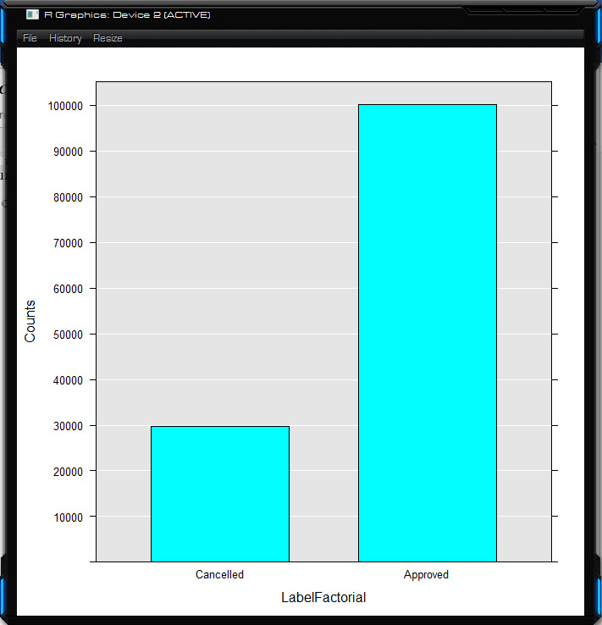
Machine Learning [2/3]
Statistics Mode
Training Set Percentage
Data Summary
Variable Information
Visualise Class Imbalance

Slide 9
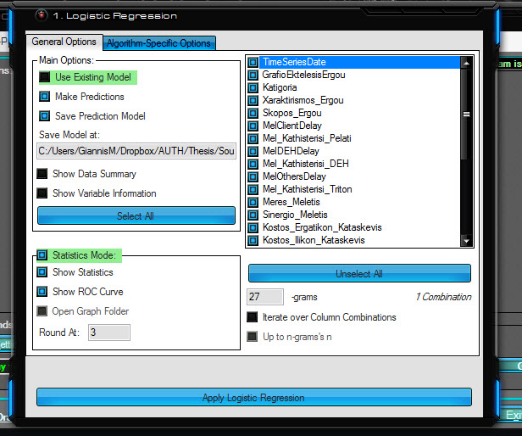
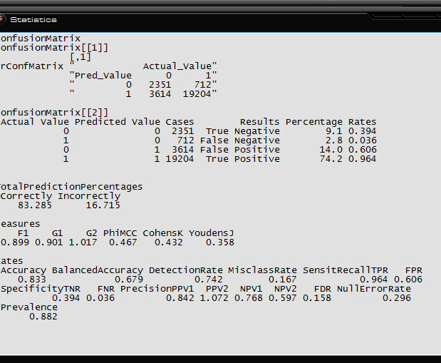
Machine Learning [3/3]
UI Uniformity
Saving Models
Showing Statistics
Showing ROC Curve
Statistics
Confusion Matrix
Prediction Percentages
Measures
F1
J
etc.
Rates
Accuracy
Balances Accuracy
etc.

Slide 10
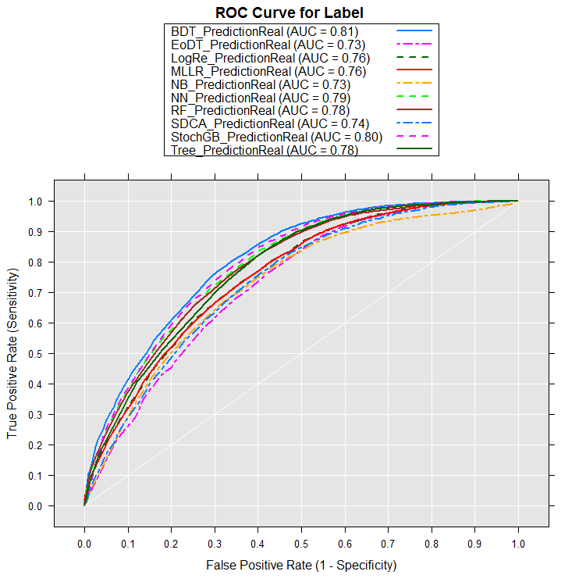
Model Evaluation
Model Name | Logistic Regression | Decision Trees | Naive Bayes | Random Forest | Stochastic Gradient Boosting | Stochastic Dual Coordinate Ascent | Boosted Decision Trees | Ensemble of Decision Trees | Neural Networks | Logistic Regression
Algorithm Name | rxLogit | rxDTree | rxNaiveBayes | rxDForest | rxBTrees | rxFastLinear | rxFastTrees | rxFastForest | rxNeuralNet | rxLogisticRegression
Correctly Classified | 80.878% | 82.635% | 77.648% | 81.098% | 82.542% | 78.072% | 79.639% | 80.305% | 82.565% | 80.932%
Incorrectly | 19.122% | 17.365% | 22.352% | 18.902% | 17.458% | 21.928% | 20.361% | 19.695% | 17.435% | 19.068%
AUC | 0.756 | 0.778 | 0.730 | 0.784 | 0.796 | 0.738 | 0.807 | 0.731 | 0.791 | 0.756
F1 | 0.885 | 0.895 | 0.868 | 0.889 | 0.891 | 0.860 | 0.866 | 0.885 | 0.896 | 0.886
G | 0.888 | 0.897 | 0.872 | 0.893 | 0.892 | 0.860 | 0.866 | 0.890 | 0.899 | 0.889
PhiMCC | 0.369 | 0.444 | 0.213 | 0.368 | 0.463 | 0.353 | 0.445 | 0.329 | 0.435 | 0.370
CohensK | 0.329 | 0.413 | 0.175 | 0.286 | 0.453 | 0.352 | 0.444 | 0.241 | 0.383 | 0.327
YoudensJ | 0.265 | 0.345 | 0.134 | 0.214 | 0.408 | 0.336 | 0.458 | 0.176 | 0.305 | 0.261
Accuracy | 0.809 | 0.826 | 0.776 | 0.811 | 0.825 | 0.781 | 0.796 | 0.803 | 0.826 | 0.809
BalancedAccuracy | 0.632 | 0.673 | 0.567 | 0.607 | 0.704 | 0.668 | 0.729 | 0.588 | 0.652 | 0.630
DetectionRate | 0.738 | 0.737 | 0.735 | 0.758 | 0.715 | 0.675 | 0.657 | 0.759 | 0.749 | 0.740
MisclassRate | 0.191 | 0.174 | 0.224 | 0.189 | 0.175 | 0.219 | 0.204 | 0.197 | 0.174 | 0.191
SensitRecallTPR | 0.960 | 0.958 | 0.956 | 0.985 | 0.929 | 0.877 | 0.854 | 0.987 | 0.974 | 0.962
FPR | 0.695 | 0.613 | 0.822 | 0.771 | 0.521 | 0.541 | 0.395 | 0.811 | 0.669 | 0.701
SpecificityTNR | 0.305 | 0.387 | 0.178 | 0.229 | 0.479 | 0.459 | 0.605 | 0.189 | 0.331 | 0.299
FNR | 0.040 | 0.042 | 0.044 | 0.015 | 0.071 | 0.123 | 0.146 | 0.013 | 0.026 | 0.038
PrecisionPPV1 | 0.822 | 0.839 | 0.795 | 0.810 | 0.856 | 0.844 | 0.878 | 0.803 | 0.829 | 0.821
PPV2 | 1.070 | 1.075 | 1.062 | 1.049 | 1.086 | 1.108 | 1.100 | 1.044 | 1.065 | 1.069
NPV1 | 0.693 | 0.733 | 0.545 | 0.824 | 0.670 | 0.528 | 0.553 | 0.812 | 0.791 | 0.703
NPV2 | 0.460 | 0.560 | 0.246 | 0.516 | 0.572 | 0.483 | 0.582 | 0.450 | 0.574 | 0.462
FDR | 0.178 | 0.161 | 0.205 | 0.190 | 0.144 | 0.156 | 0.122 | 0.197 | 0.171 | 0.179

Slide 11
Conclusions
High efficiency
A gateway to reaching the end goal effortlessly
Maximising financial outcome & work potential
Predictions
Approved/Cancelled Projects
Allows for items to be readily available
Projects continue smoothly
Real Data
High degree of noise
Investment on pre-processing
Automation
Programme with GUI
Customisability, Scalability
10 Machine Learning Algorithms

Slide 12
Machine learning methods for the analysis of data of an Electricity Distribution Network Operator
Master’s thesis
Aristotle University of Thessaloniki, Faculty of Sciences, Department of Informatics
Supervisor: Dr. Eleftherios Angelis; Thesis Committee: Grigorios Tsoumakas, Ioannis Vlahavas
Thank You !
Ioannis Mamalikidis, UID: 633

